Slide 1
YOUR ATTITUDE SUCKS
AND SO DOES EVERYONE ELSE’S

Slide 2
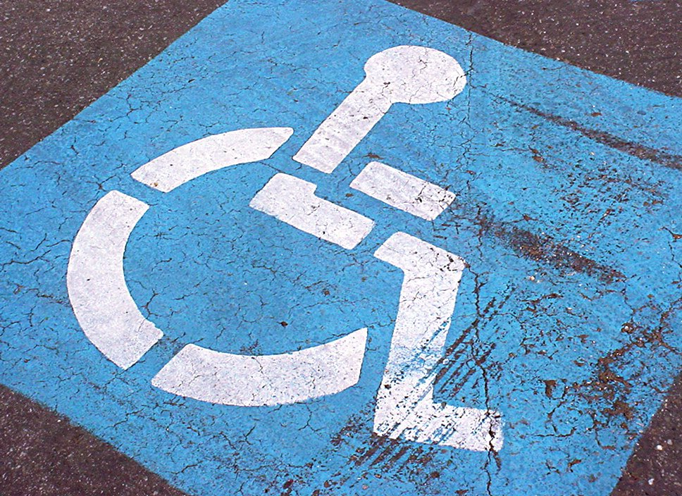
First thoughts
=
© Gabriel Doyle; Maare Liiv
Notes:
Hi, I’m Katherine Deane. What would your thoughts be if I told you that I am a wheelchair user, with a mild visual impairment and at times have mild cognitive impairment, anxiety and depression. What would you assume about me? Do I have a family, friends? Do I work? Have a social life? Am I happy?
What if I told you that actually I’m Dr Katherine Deane, BSc, PhD, Senior Lecturer in Research at the University of East Anglia with research expertise in the management of long term conditions. I am the access ambassador to my university. I have a husband and son and a wide group of friends. I love Terry Pratchett books and gardening.
Do I match up with any of your first thoughts?
Don’t worry – everyone has “interesting” first thoughts, unconscious biases, these are the short cuts our brains use to navigate through our complex world. They reflect societal paradigms and it’s helpful to realise that society has some quite broken paradigms about illness and disability. If we don’t examine and challenge these it can lead to us expressing views and using language that can be unacceptable to the very people you want to come to your venue – not helpful.

Slide 3
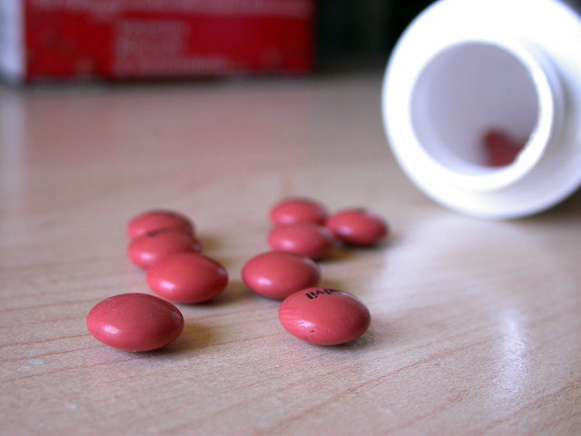
© Aleš Čerin; Kurhan; James Lin; Invacare
Notes:
I want to help you get past the first thoughts and on to your second thoughts where you have more control over your ideas and attitudes.
One of the key societal paradigms is that you are less valuable, less worthy if you have a disability or illness – you are broken and need to be fixed. The medical model of disability focuses on solving the impairment in order to allow patients to regain normality and status. The problem lies solely with the patient. Please note this isn’t me having a dig at medics and medicine – the medical model is a name for a problematic way of thinking about disabled people

Slide 4
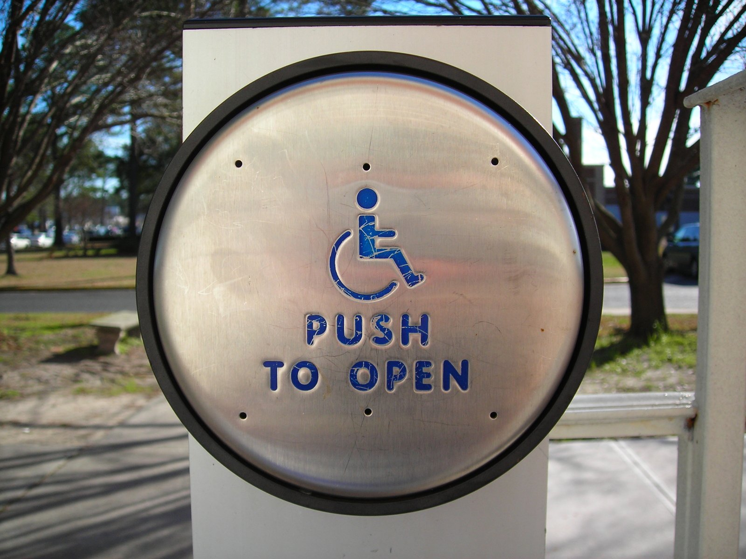
©
© UEA; Kevin Jamieson ; Gabriel Doyle
Notes:
The social model of disability challenges this idea and says that we are disabled by the way society is organised, rather than by a person's impairment or difference. It proposes that if we just removed these barriers people with impairments wouldn’t be disabled. And this is your challenge as a venue – are there barriers built in to your venue that are disabling some of your visitors?

Slide 5
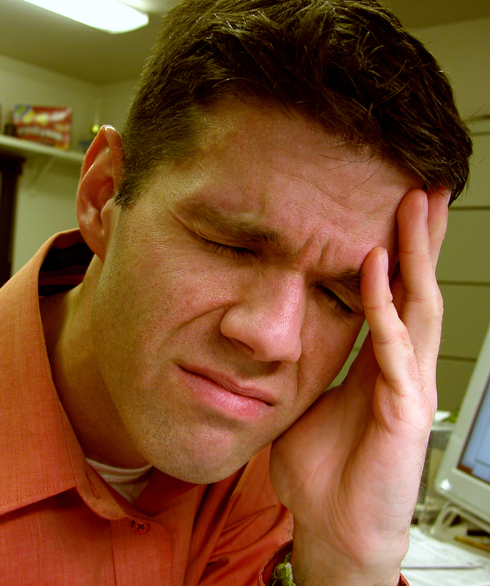
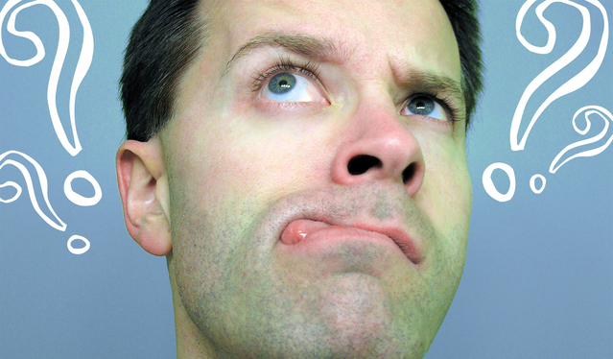
FATIGUE
PAIN
BRAIN FOG
© James Lin; Mike Johnson; Gözde Otman; Bob Smith
Notes:
But please remember that the majority – about 80% of disabilities and impairments are invisible. Yes I use a wheelchair but the really impactful aspects of my disability are these – pain, fatigue, brain fog – and I don’t have dials on my T-shirt telling you how much I’m dealing with today.

Slide 6
© Patrick Öxler; carl dwyer
Notes:
I am not an inspiration if I just got up, dressed and came in for a meeting. If I climbed Everest, then yes that’s inspirational, that’s an extraordinary act. But just going about my everyday life, no. I’d appreciate respect for getting on with life but being told I’m inspirational for just existing that’s insulting. This is also known as inspiration porn and a link for a wonderful TED talk by Stella Young on this is on the last slide.

Slide 7
But its not that common…
© Roma Flowers
Notes:
But there aren’t that many disabled people is another common fallacy. Actually there are approx. 14 million disabled people in the UK – that’s 1 in 5 of the population – its lower in children around 6%; but around 15% of working age adults are disabled. Remember – most of this is invisible – can you tell me who in this picture has diabetes, epilepsy, a learning disability? That said if you want to make sure disabled people know they would be welcome at your venue you might want to consider having pictures on your website of people with visible disabilities

Slide 8
Watch your language
© typexnick
Notes:
Your first thoughts can also impact on your use of language. If you call me wheelchair bound I will correct you and say my chair is a tool for freedom and so I’m a wheelchair user. People with Parkinson’s object to the term “disease”. People who are deaf will object to being told they have a disability or that they are impaired – its society that disables them by not knowing sign language, being deaf is no problem. So it’s worth you getting familiar with terms that are acceptable to your visitors. That said don’t over worry about this – ask how people would like to be addressed and do that.

Slide 9
Its complex – please ask
© Bensik Imeri
Notes:
Society has some very odd and often incorrect ideas about disability. So keep an open mind and ask your visitors to advise you on how to be respectful to everyone.

Slide 10
Dr Katherine Deane Senior Lecturer and Access Ambassador School of Health Sciences k.deane@uea.ac.uk
Notes:
And here are my contact details. Feel free to contact me for further information on all of this. Thanks to Winchester Science Centre and Planetarium for asking me to create this talk. Thank you for watching.

Slide 11
Useful Links
TED talk by Stella Young: “I’m not your inspiration thank you very much” https://www.ted.com/talks/stella_young_i_m_not_your_inspiration_thank_you_very_much
Fabulous communication resources by Hannah Ensor who really demonstrates how to use the “right” language http://stickmancommunications.co.uk/
Social model of disability https://www.scope.org.uk/about-us/our-brand/social-model-of-disability
Language guide https://m.paralympic.org/sites/default/files/document/141027103527844_2014_10_31+Guide+to+reporting+on+persons+with+an+impairment.pdf

