Slide 1
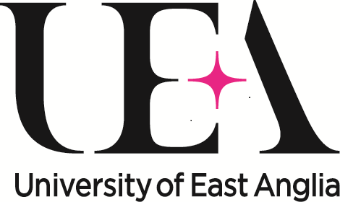
The advantages of being a disabled scientist
Notes:
Hi I’m Dr Katherine Deane Senior Lecturer and Access Ambassador for the University of East Anglia in Norwich.

Slide 2
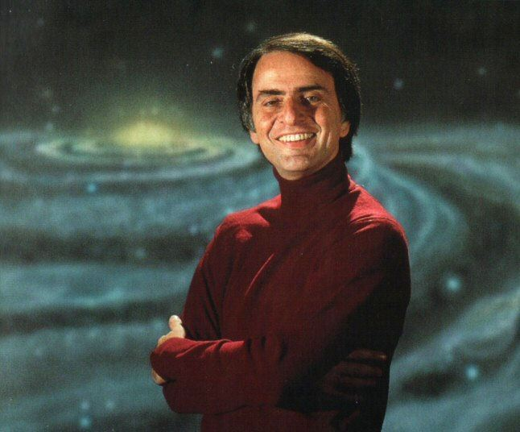
Credit: Brain pickings
Notes:
Carl Sagan “The nitrogen in our DNA, the calcium in our teeth, the iron in our blood, the carbon in our apple pies were made in the interiors of collapsing stars. We are made of star stuff.” “Every one of us is, in the cosmic perspective, precious. In a hundred billion galaxies, you will not find another.” So every precious human should be able to enjoy the excitement that science can offer

Slide 3
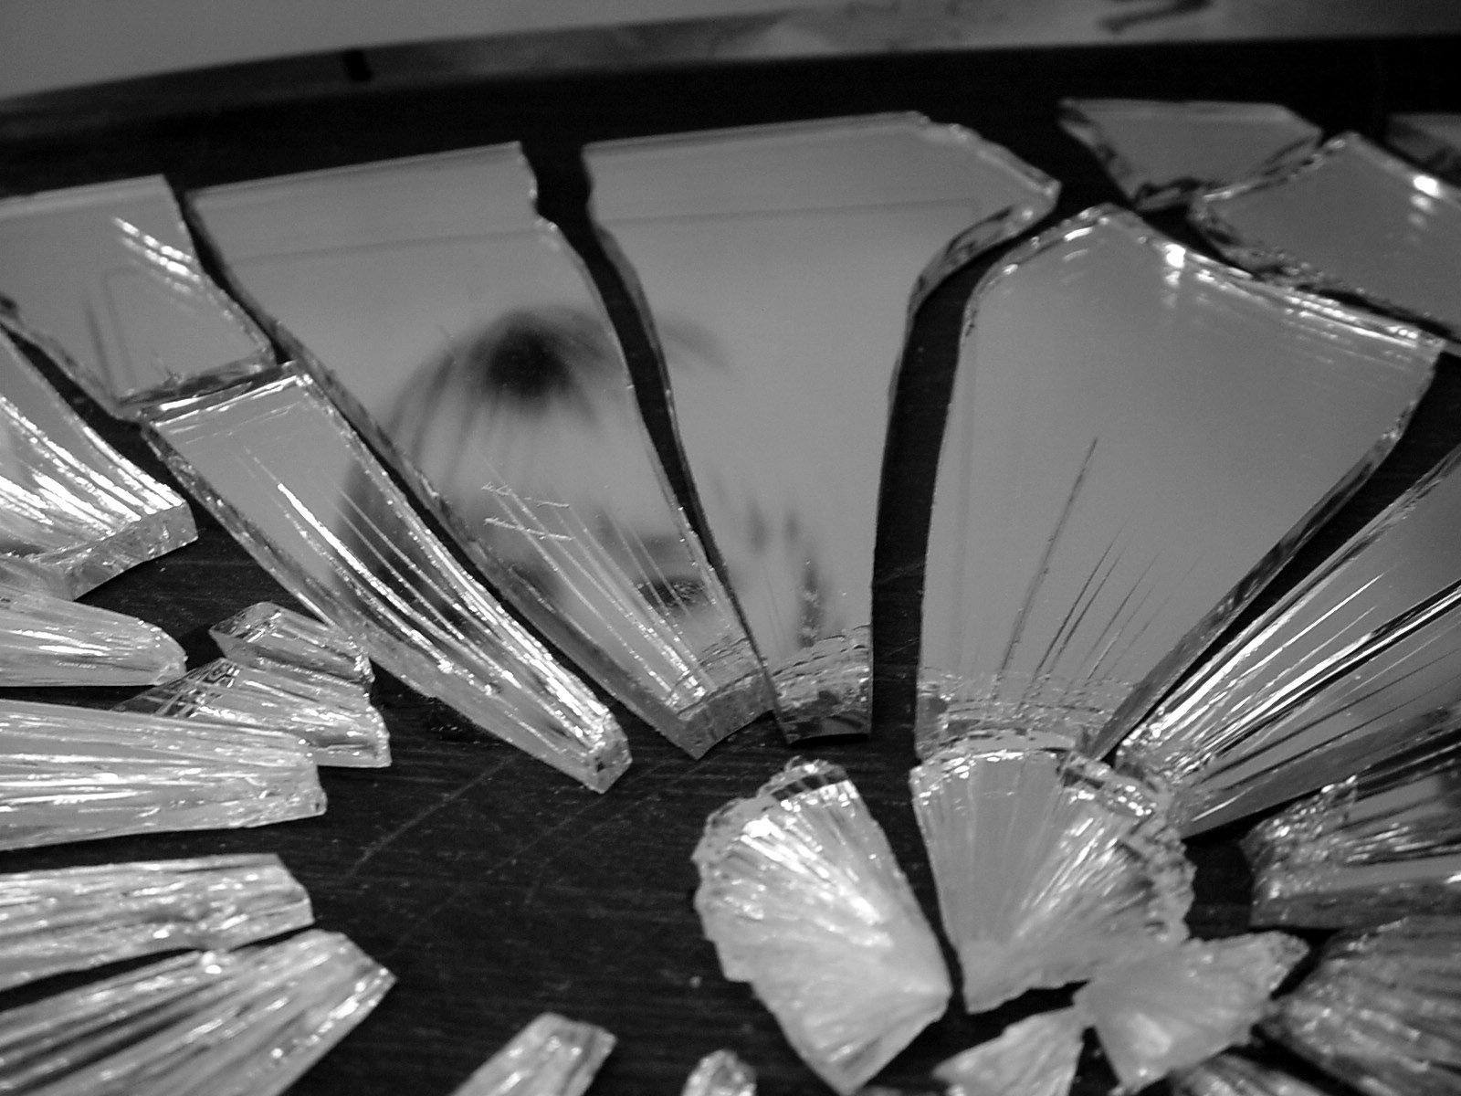
© Katherine Evans
Notes:
As a society we’ve been sold a lie – disability is universally bad – we are broken – we are to be pitied as there is nothing positive to take from this situation – its all black and dismal.
And that’s a lie – a big lie – and this lie is unhelpful in all aspects of living with a disability but I’m going to call it out particularly in relation to science

Slide 4
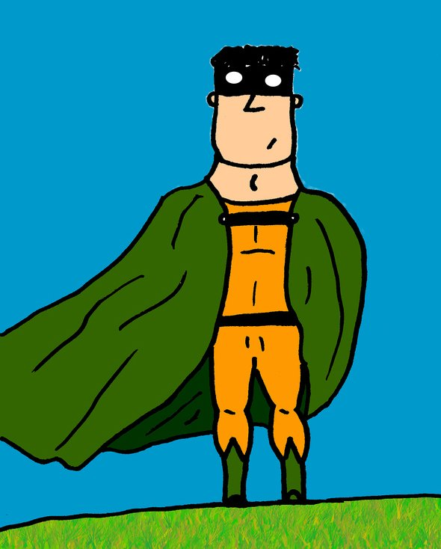
© Ben Smith
Notes:
What if we had it wrong – rather than being a problem what if disability was our super power? What if science in particular needed people that are coming to the ideas from a different perspective?

Slide 5
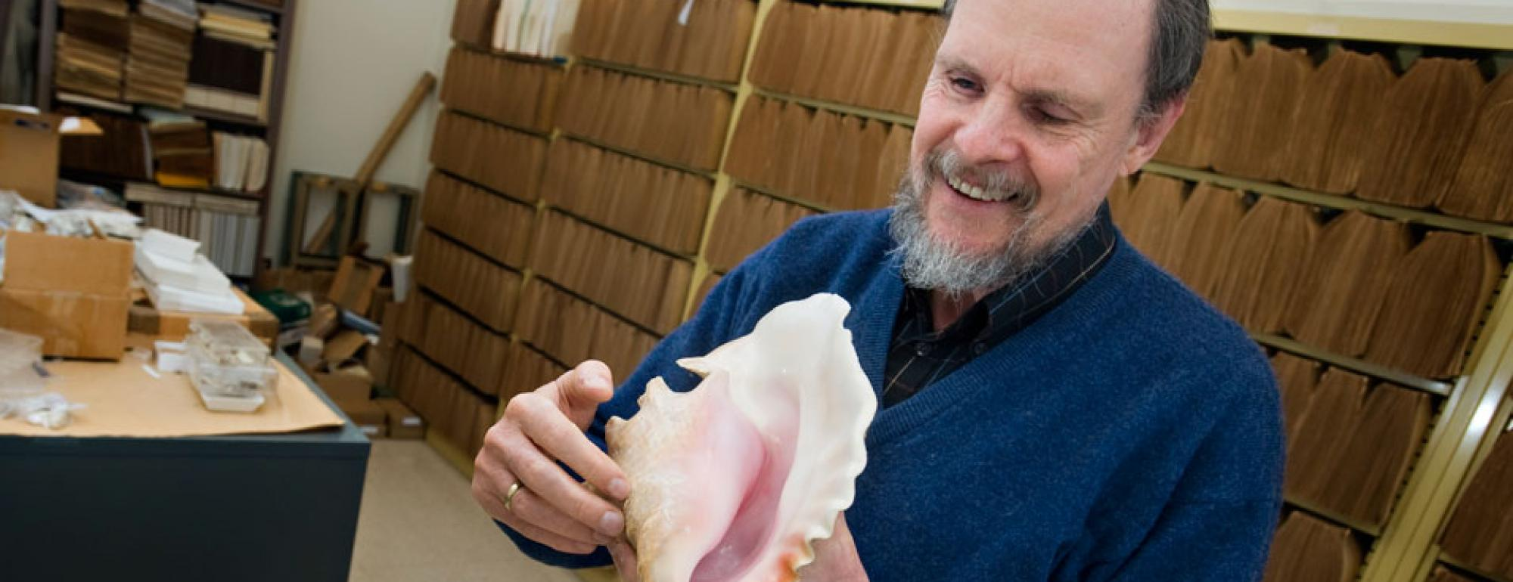
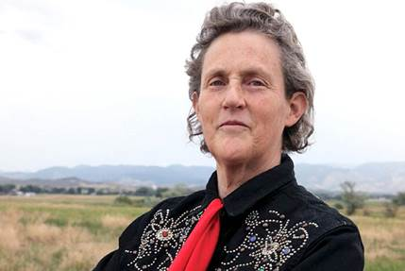
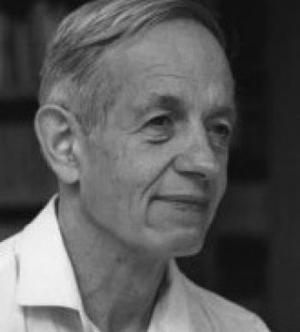
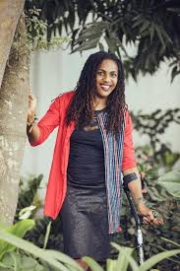
Credits: Princeton University; Global Animal Partnerships; UCDavis; ; Kriphopnation
Notes:
Here we have four scientists with a range of expertise and disabilities
John Nash Jr., was a legendary fixture of Princeton University’s Department of Mathematics renowned for his breakthrough work in mathematics and game theory – and also had schizophrenia
Temple Grandin’s autism allowed her a unique opportunity to understand animal behaviour & emotion.
Geerat Vermeij is a paleontologist and his work shows a singular insight into evolution. His research highlights the detail of layers and shapes that might otherwise go unnoticed which he notices because he touches fossils as he is blind
Farida Bedwei is a Ghanian Software Engineer who has worked on micro-banking systems for financial institutions. She is also a disability rights advocate, and author, and has cerebral palsy

Slide 6
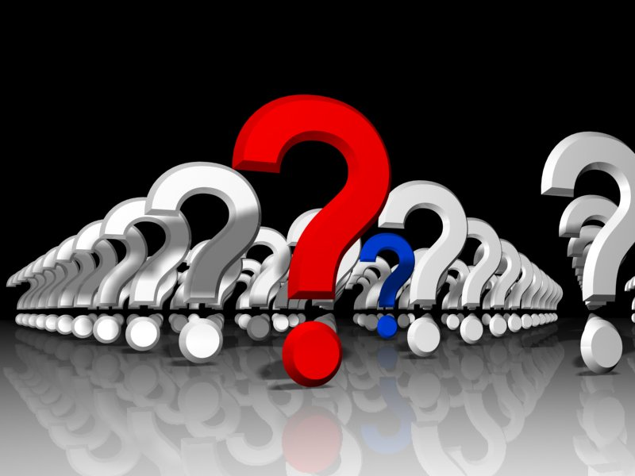
© Chris Baker
Notes:
Carl Sagan said “Science is far from a perfect instrument of knowledge. It’s just the best we have. In this respect, as in many others, it’s like democracy. Science by itself cannot advocate courses of human action, but it can certainly illuminate the possible consequences of alternative courses of action.
Science is a way to call the bluff of those who only pretend to knowledge. It is a bulwark against mysticism, against superstition, against religion misapplied to where it has no business being. If we’re true to its values, it can tell us when we’re being lied to. It provides a mid-course correction to our mistakes.”
Science welcomes diversity - its often driven by the quality of the questions we ask – and for that we need a lots of different perspectives. So Science centres need to cater to this diversity to ensure everyone is inspired by science and so all of society is more scientifically literate.

Slide 7
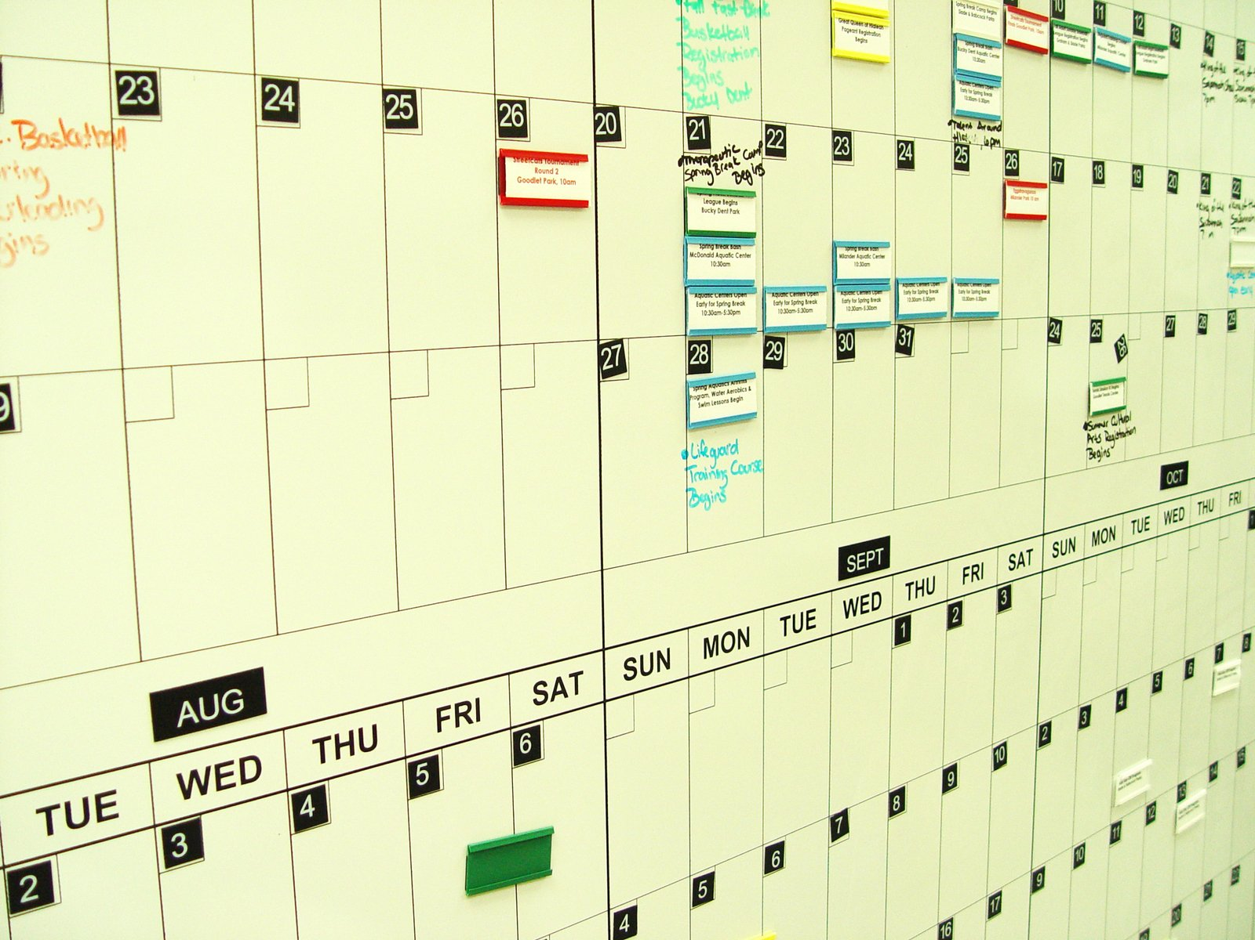
© Elvis Santana
Notes:
Disabled people often have skills that are hugely advantageous to being a scientist – they just may not know it. The first skill I want to talk about is time and energy management. Disabilities have a tendency to come with fatigue issue, concentration is only available for limited times in the day – so people with disabilities already come knowing how to pace their day, how to not overload themselves with too many high effort items in a single day, - working at doing more by doing less – pacing everything – because that way they don’t crash and burn and need to sleep for a week after doing too too much. One thing I can assure you of – you don’t need a disability to need to learn how to pace – no one has the energy or time for everything that is on offer in life – you need to choose where you put your energy and time – irrespective of disability – disabled people usually already know how to do this at least a bit – and that is a huge advantage

Slide 8
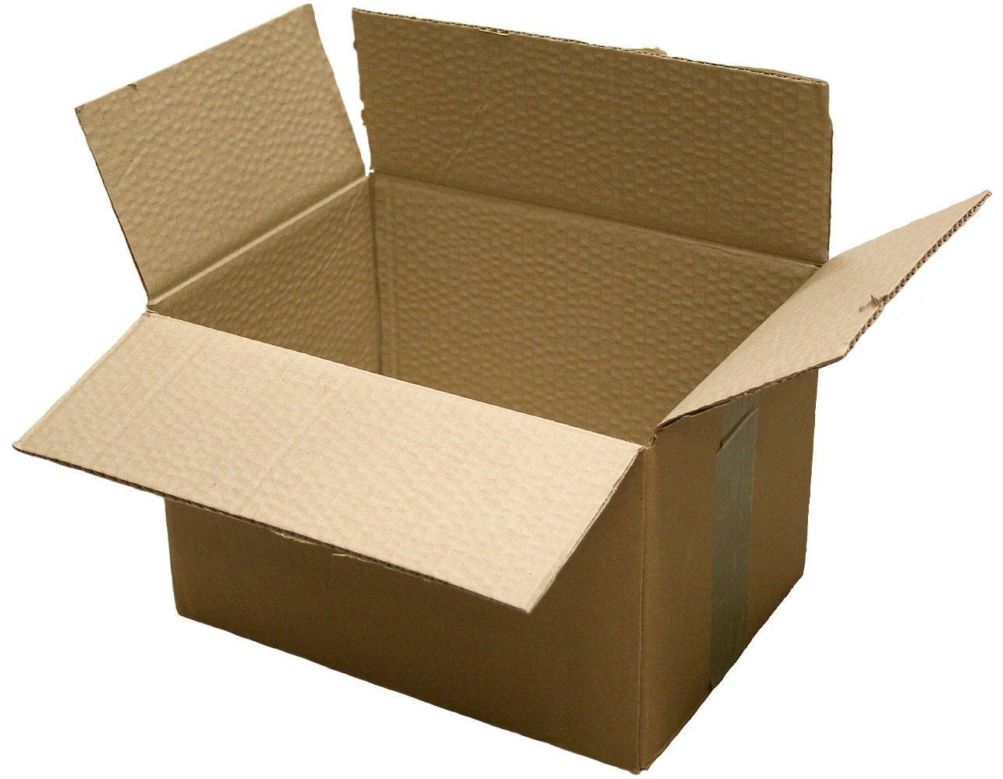
© Pascal THAUVIN
Notes:
Next advantage – disabled people are brilliant at thinking outside the box to solve problems – they are living in a society that forgot to design the built environment with their needs in mind. They are excellent at finding alternate routes, planning in advance, communicating their needs – all in order to get on with their everyday lives – and these skills are absolutely needed in science. We desperately need innovators and entrepreneurs to help solve todays problems with innovative thinking – and we are sure the viewpoints of disabled people are critical in helping is find those solutions

Slide 9
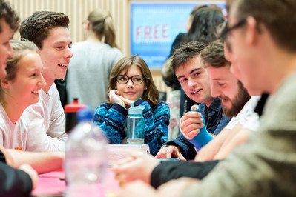
© UEA
Notes:
And its something we’ve already touched on – but disabled people usually have brilliant communication skills. Negotiating everyday life with a disability requires you to be able to explain your needs – often with tact and diplomacy – can you fold up that buggy please so I can fit into that wheelchair space on this bus? – can you open that heavy door for me? – can I check that food is safe for me? Good communication skills are essential in science and people with disabilities tend to have them in spades. .

Slide 10
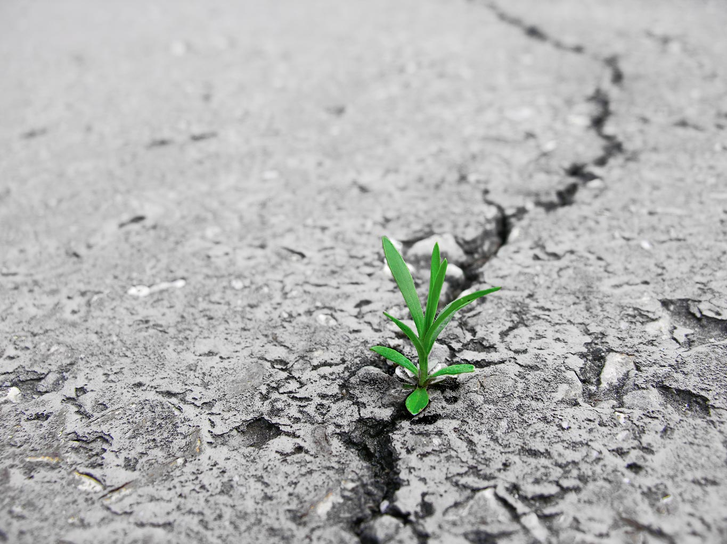
© Bob Smith
Notes:
And then there is persistence and determination. Disabled people know how to set goals, how to take the little steps required day-after-day to reach that goal, how to get up after being knocked down, how to deal with the self-doubt demons. They are resilient and you need resilience to complete science projects.

Slide 11
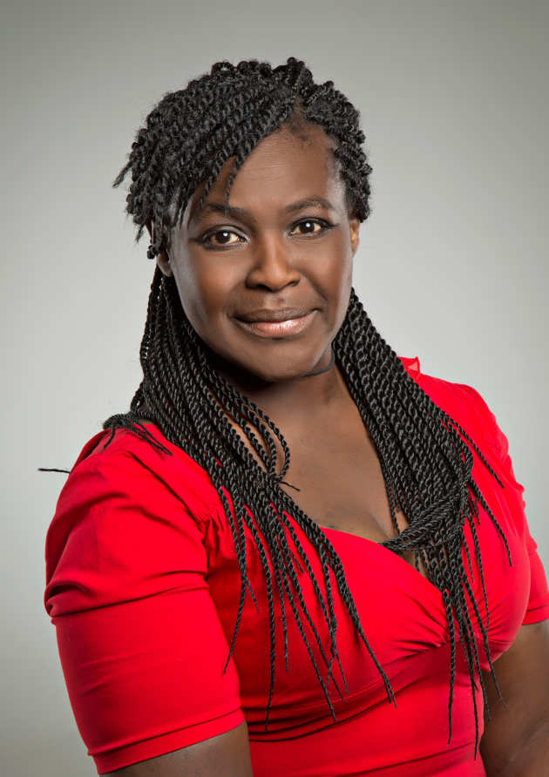
© Imperial College London
Notes:
Some disabilities come with more specific skill sets. Its estimated that around 10% of the population have dyslexia. This includes Dr Maggie Aderin-Pocock, space scientist and science communicator. She says “As a scientist, I have found that I am able to take complex ideas and simplify them, story tell and bring science ideas to life in my own unique way, this has been a huge advantage.” Dyslexics are often more visual, have better spatial awareness, they see things more holistically, they are good at spotting things that don’t fit / are out of place.

Slide 12

© Autism UK
Notes:
Another common disability – about 1-2% of the population are autistic. This can give the advantage of great focus and deep understanding of a subject. Sometimes it means they have greater capacity to handle numbers and analysis. I supervised a PhD student who had autism – when we give his thesis to other students we warn them – you are neurotypical – you don’t have the advantage of autism so you’ll only be able to do a third of the analysis he did.

Slide 13
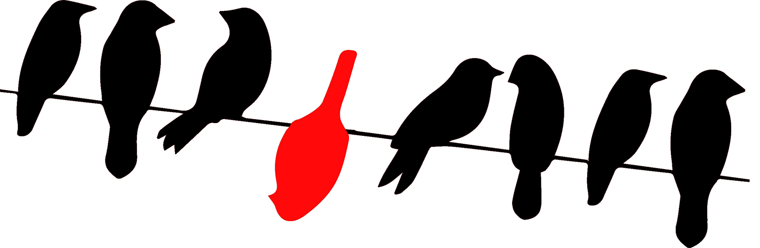
© UEA
Notes:
I am speaking from personal experience. I’m disabled, and I’m a scientist – a healthcare researcher. I trained as a biologist and worked in lab research until I got ill. As shaking uncontrollably is really not a good thing to do in a lab when you are handling multiple hazards I had to change my plans. So I went from looking at health at the level of cells in the lab to looking at the health of patients in the community – I had to research differently. I was a good enough lab researcher, but I am a brilliant healthcare researcher. I work with disabled people to make sure health research is asking the right questions, in the right way – which tends to make it a bit more relevant and successful.

Slide 14
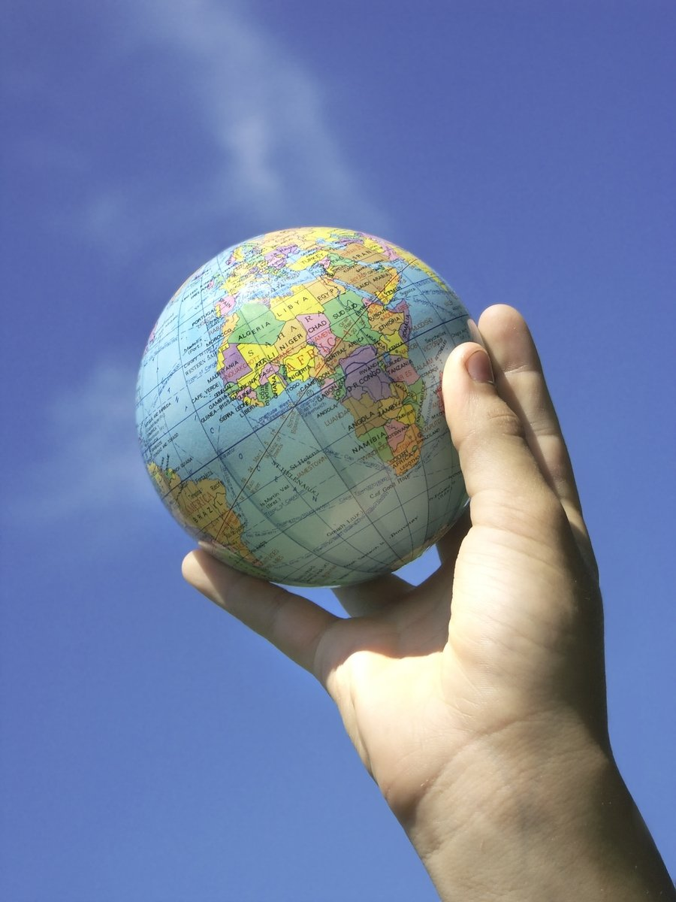
© Sherrie Smith
Notes:
But don’t think because someone has a disability or difference they will only be interested in health research only. There is a world of research at their finger tips. We need answers to global warming, to how super massive black holes form, to how to stop dementia, to finding alternatives to plastic on and on and on. We need diversity of views in all of these areas – we need more scientists with more ideas. So I will happily put on my access ambassador hat and work with you to look at the accessibility of your science centre because if your venue isn’t accessible it says disabled people can’t be scientists – and that just isn’t true.

Slide 15
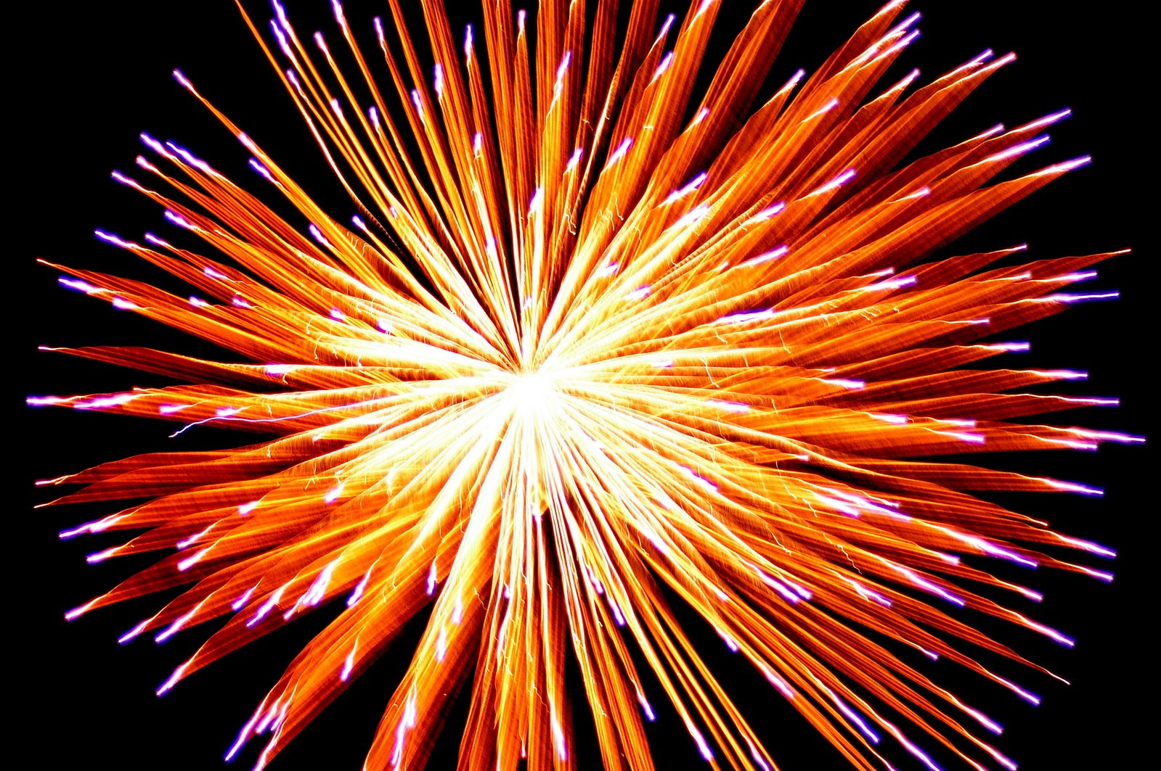
© Zoran Nickolic
Notes:
So – no we are not denying that having a disability can be challenging – some disabled visitors to your venue will need extra support and sometimes it will cost more to accommodate their needs– but know that if you design your venue to support disabled visitors it shows you recognise and value them as the scientists of the future. Your venue is brilliant – I am offering my help to make sure all of your visitors feel the same.

Slide 16

Dr Katherine Deane
Senior Lecturer and Access Ambassador
School of Health Sciences k.deane@uea.ac.uk
Notes:
And here are my contact details. Feel free to contact me for further information on how to design your science centre, its displays and your events so they work for everyone. Thanks to Winchester Science Centre and Planetarium for asking me to create this talk. Thank you for watching.

