Slide 1
Disabled Access Post-Covid Lockdown
Please don’t forget us

Slide 2
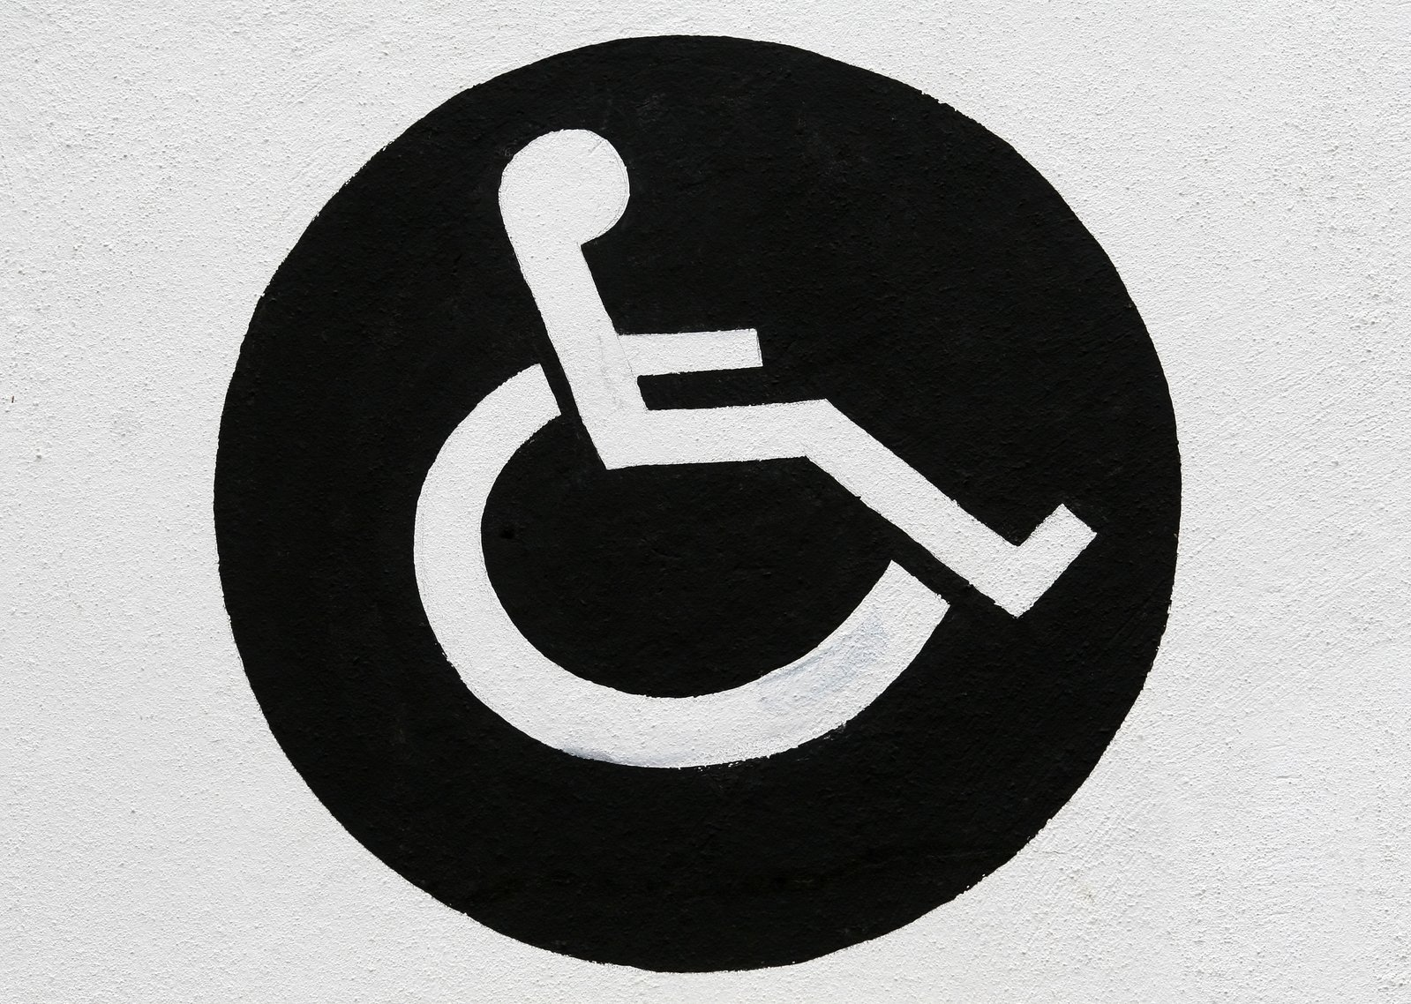
Welcome to the new normal
© Robert Owen-Whal
Notes:
We know that the Covid-19 pandemic is going to have massive impact on how venues work, even once lock down is lifted. I’d like to give you a few thoughts about how it will particularly impact your disabled visitors

Slide 3
Two groups
Medically at Risk
Immunocompromised
Lung or heart diseases
“New” disabled
Other Disabilities
Learning disability, Autism
Blind or Deaf
Mobility impairments
Notes:
In this context there are two groups of disabled people – those at particular risk of Covid-19; and those with other disabilities which do not make them directly more at risk of Covid-19 but for whom the changes needed to control Covid may still have negative impact. Those who are particularly at risk will include those whose immune system is affected, those with lung or heart diseases. But it will also include people who previously would not have considered themselves as disabled – but who are now being disabled by their higher risk from Covid-19 – those who are over 70 year old, those with conditions that would previously have been regarded by many with them as mild health issues eg asthma, diabetes or high blood pressure.
The other disabilities listed – LD, autism, being blind or deaf, even having a spinal injury and so using a wheelchair – don’t make you at greater risk from Covid-19 but you do still need to consider the impact of Covid-control precautions and just the general access issues these groups have when accessing your venue. Please do not use Covid as an excuse to defer access improvements.

Slide 4
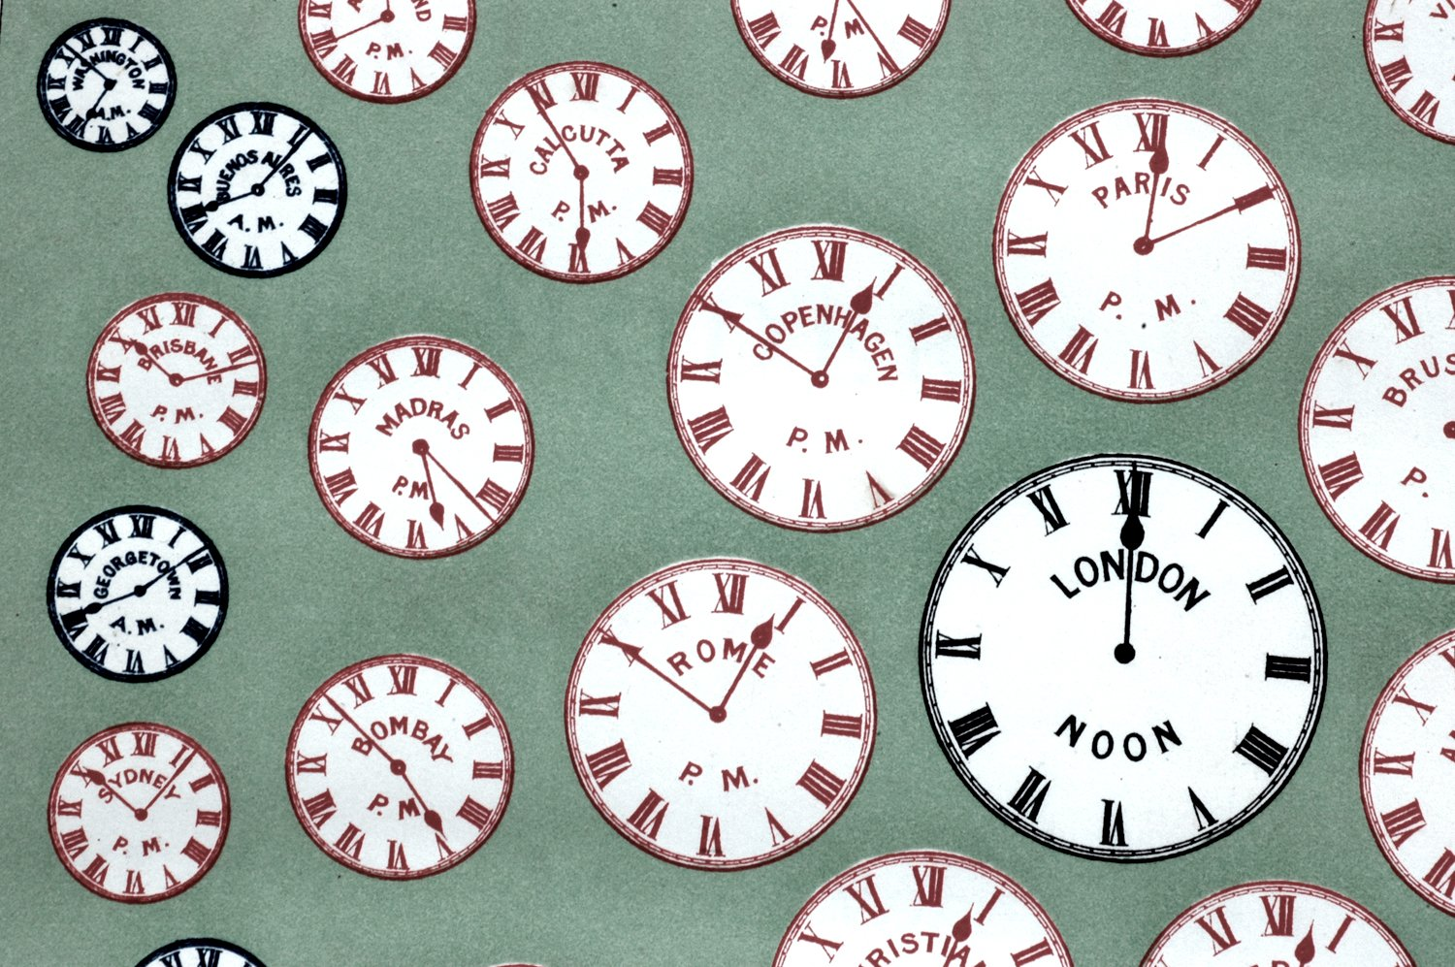
Long term access
© Jenny Rollo
Notes:
For the disabled people that are medically at higher risk from Covid-19; they and their families will be trying to keep social contacts reduced for a lot longer period than the rest of the population – personally as someone at high risk (but not the highest) I expect to be mostly working virtually until there is a robust track and trace system and ideally a vaccine – which may be up to 2 years away. So going to a science centre or a museum is very low on my priority list – I would just feel so unsafe the whole time I was there that I wouldn’t enjoy the day

Slide 5
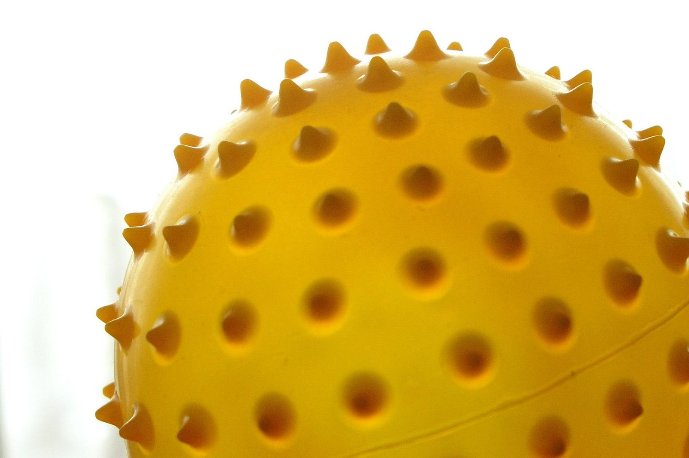
Remote Access
© Davor Fanton
Notes:
Shut down due to corona virus has led to massive changes. Social isolating has made virtual living the new normal. As a disabled person suddenly I can access the Louvre, the V&A, art collections. Even if I could have gotten into these buildings I would have struggled to find the energy and time to go and visit- and now its all just on my laptop. So when lock down lifts please continue to offer these online options. Livestream your visiting speaker events and allow questions to be posted online. You can charge if needed but please don’t shut our worlds down again just as they were being opened up.

Slide 6
The power of the Web is in its universality.
Access by everyone regardless of
disability is an essential aspect.
Tim Berners-Lee, W3C Director and inventor of the World Wide Web
Notes:
Please check out the accessibility of your web site – the minimum standard to meet is W3C. If you can check that your website is also accessible on phones as well as computers, to text readers, and allows text size and contrast to be changed you are doing well. Make sure your pictures have logos, your videos have closed captions (and ideally British Sign Language interpreters).

Slide 7
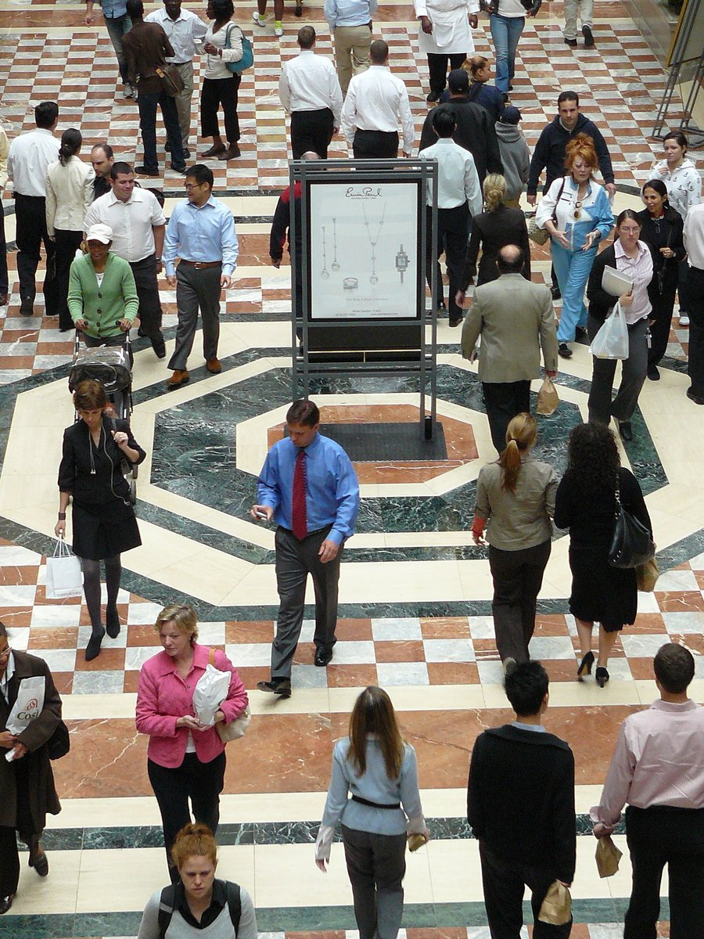
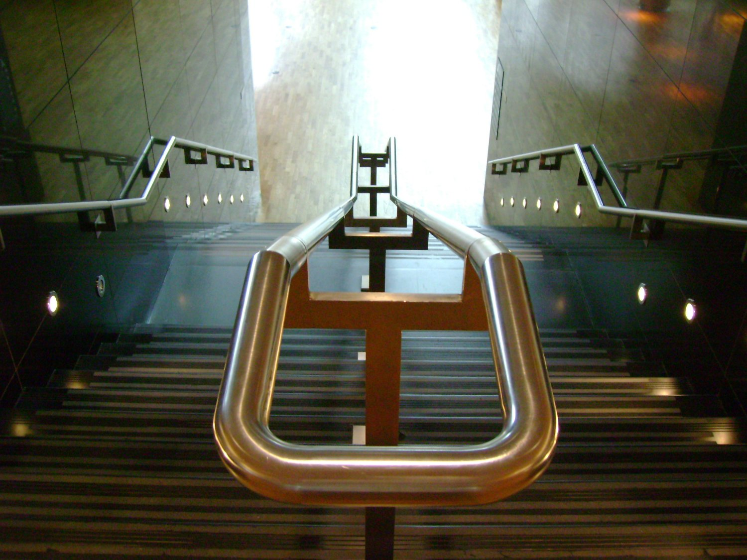
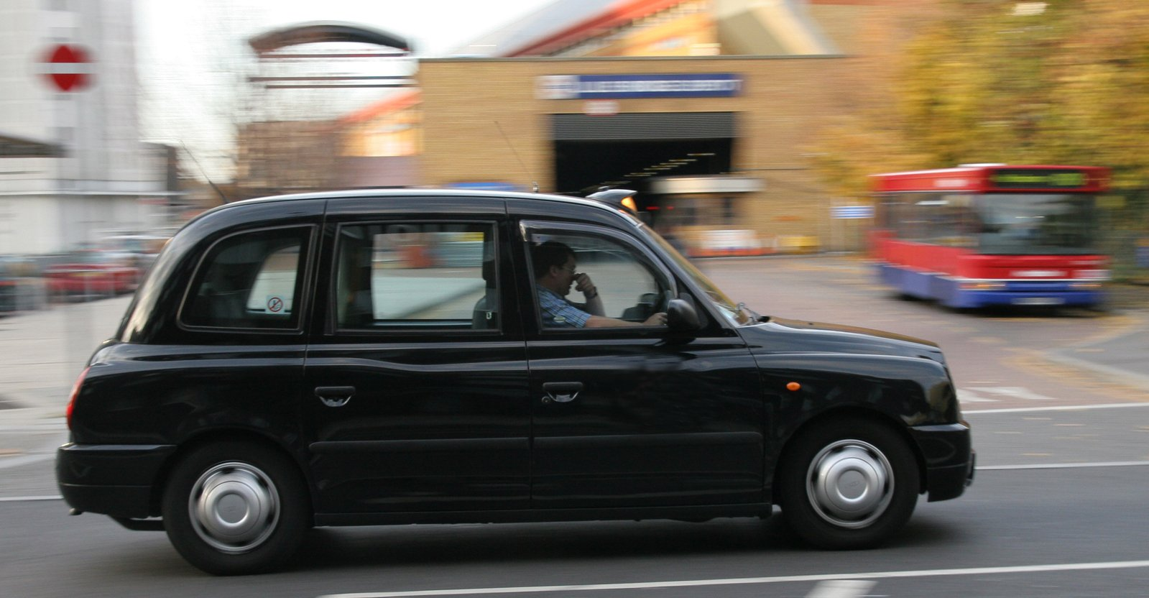
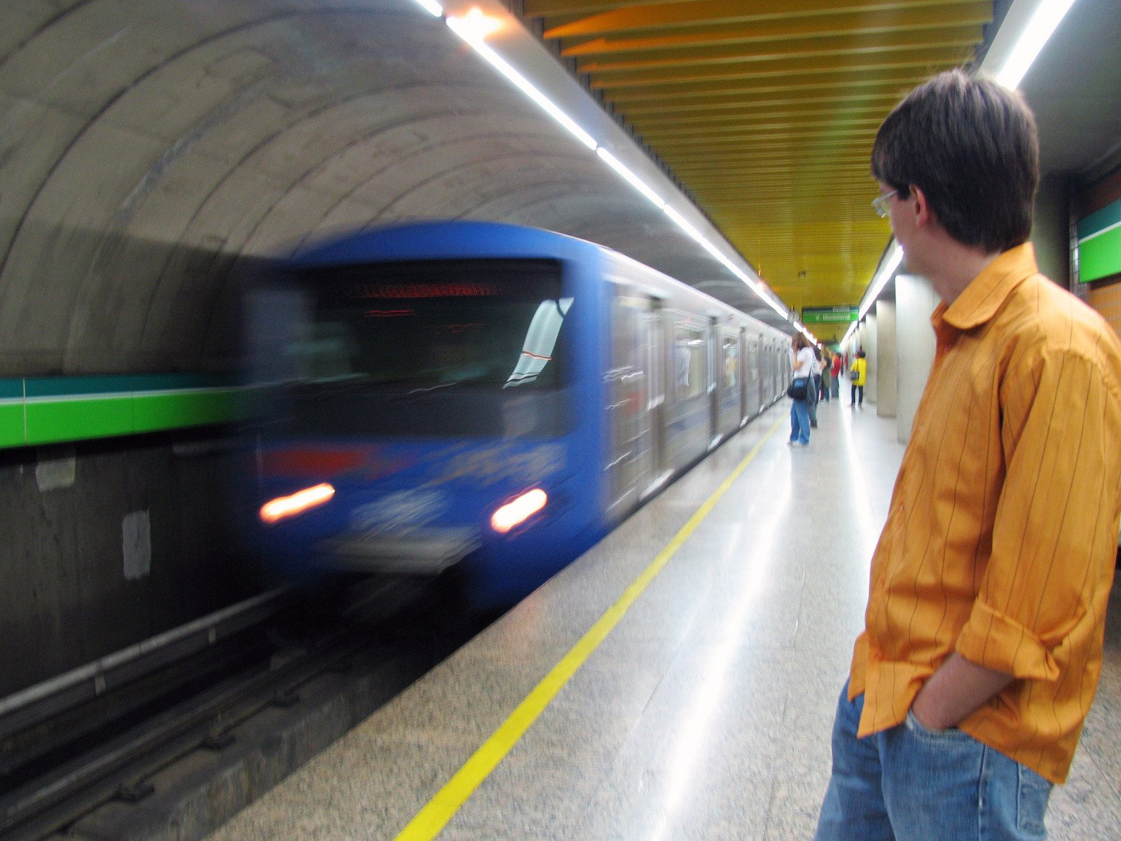
Travel is challenging
© bugdog; Luiz Farias; amr HASSAN; Roma Flowers
Notes:
Travel as a disabled person is challenging - then add in Covid and it becomes really hard. We are being advised against using public transport but many disabled people cannot drive so our transport options get fewer and fewer. Many disabilities mean that specialist transportation and/or additional assistance (often not socially distanced) is needed to travel. So unfortunately even if a disabled person isn’t at greater risk from Covid they still may not be able to travel to you.

Slide 8
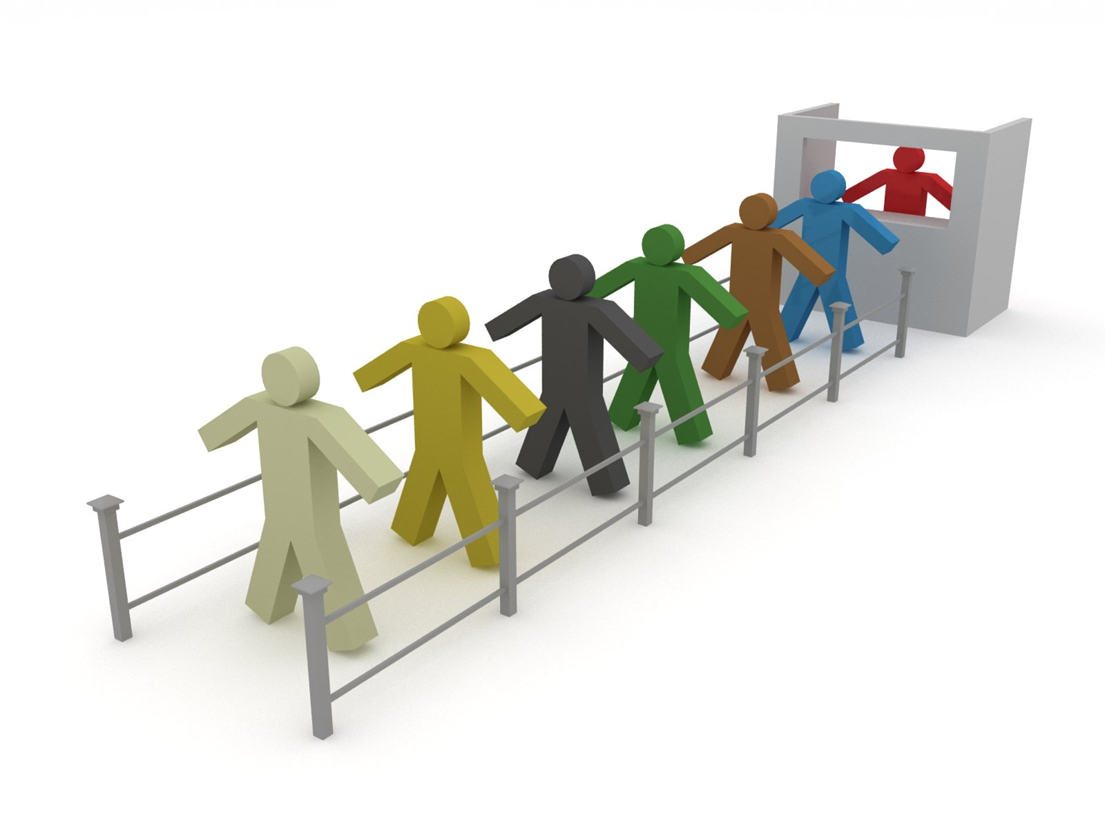
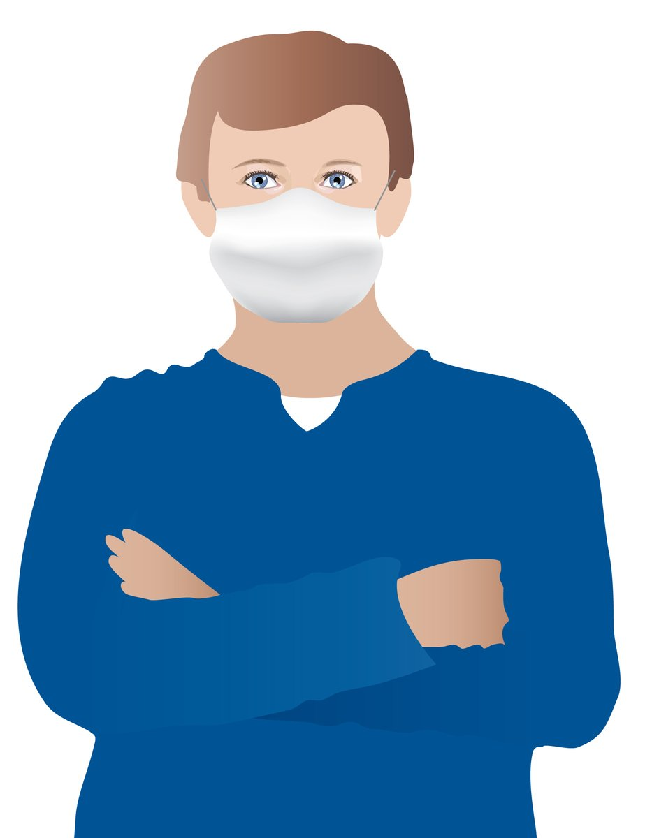
Social distancing plus disability is often impossible
© Sigurd Decross; hana erel
Notes:
Many times disability means that social distancing is virtually impossible – if you need your wheelchair pushing, there is no way to do this and maintain 2 meters distance. Guiding someone who is blind can’t be done in a socially distanced way. . And guide dogs will go straight to your front door ignoring any socially distanced queues. Face masks are a communication nightmare for those who lip read. Many people with LD or dementia will struggle to understand or adhere to social distancing rules.

Slide 9
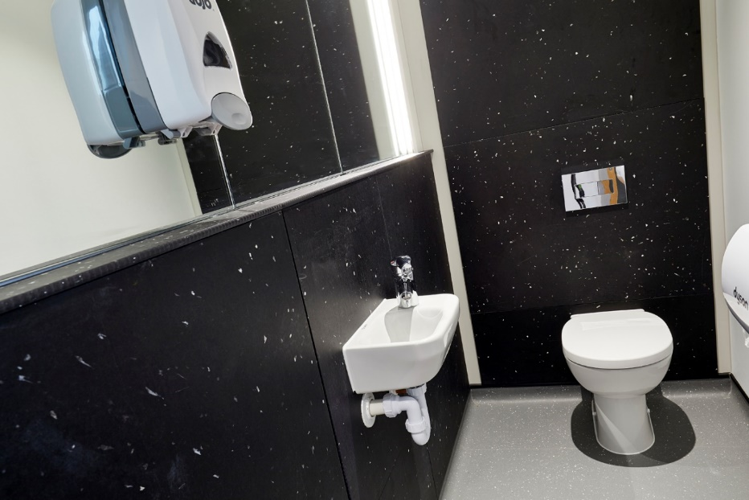
Public toilets are scary
© Davor Fanton; UEA
Notes:
Public toilets – accessible or otherwise – are a real source of concern. The virus is present in faeces, so potentially an infection risk. That said a quick review of the literature does not identify any known cases. But it would be fair to apply a precautionary principle here. So protecting someone when using a public toilet is a huge challenge. You do need to ask people to close the loo seat before flushing (so reducing aerosols). And your cleaning regimen needs to be massively increased – the ideal is after each use (yes seriously). If possible consider installing touch free taps and flush sensors.

Slide 10


Dr Katherine Deane
Senior Lecturer and Access Ambassador
School of Health Sciences
k.deane@uea.ac.uk
Notes:
Here are my contact details. If you’d like to discuss any of this in more detail please feel free to get in touch. Thanks to Winchester Science Centre and Planetarium for asking me to create this talk. Thank you for watching.

